Slide 1




Services
Angular Basics

Slide 2

Table of Contents
What is a service
Why using services
Custom services
Built-in services

Slide 3

What Is a Service

Slide 4

What Is a Service
In Angular service is
A worker object
Easier use of different aspects of the app
Over-the-Wire or not
Often stateless

Slide 5

Why Using Services

Slide 6


Why Using Services
Services are:
Reusable
"SOLID"
Dependency Injection
Testable

Slide 7

Custom Services

Slide 8
Custom Services
Create Custom Services
Inject it in a controller
module.factory('serviceName', function (services){
// implement service
});
eventsApp.controller('Ctrl',
function Ctrl($scope, serviceName) {
// use service
}
);

Slide 9
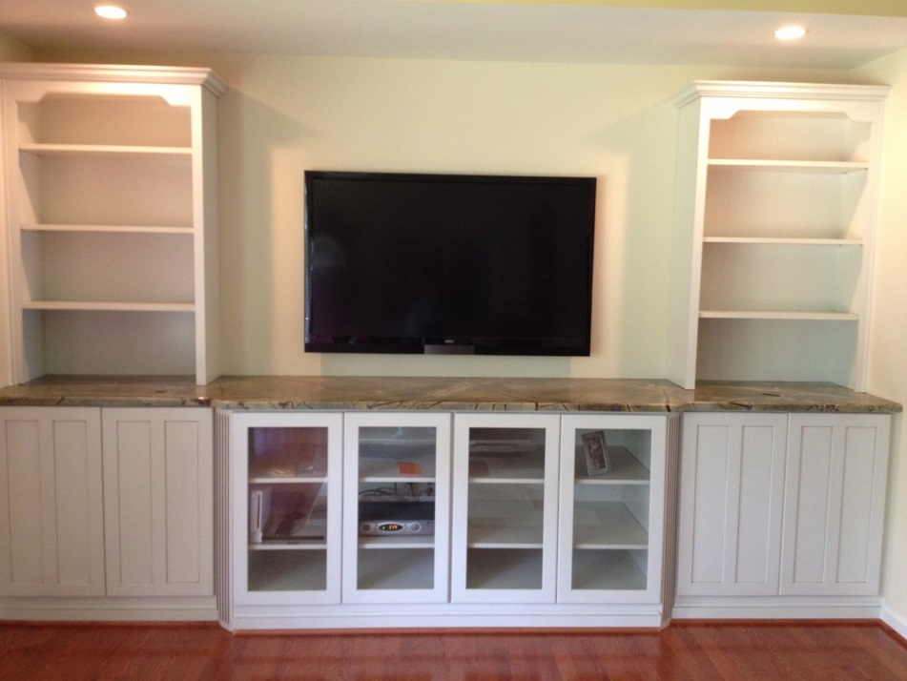
Built-in Services

Slide 10
Built-in Services
Built-in Services
$http – AJAX request
$resource – AJAX with restfull services
$q – Promise library
$anchorScroll – Scrolls to element
$cacheFactory – cache service (key-value pair)
$compile – compiles element with directives
$parse – parses expressions
$locale – localization of dates, numbers
$timeout – timeout with compiling
$exceptionHandler – handling exceptions
$filter – access to filter functions
$cookieStore – cookie sessions usage

Slide 11
Built-in Services
Other Built-in Services
$interpolate – modifies the {{ template
$log – logs into the console
$rootScope – the "base" scope (avoid using it)
$window – the window
$document – the document DOM element
$rootElement – the root of the app
$route – for routes
$routeParams – retrieve route parameters
$location – parses the URL
$httpBackend – fake HTTP (for testing)
$controller – instantiates controllers

Slide 12
Summary
Angular services
Custom services
Built-in services

Slide 13
AngularJS
http://academy.telerik.com

Slide 14
Exercises
Update the save method of the artistData service to lookup next artist Id by finding the highest artist id of all existing artist and incrementing by one
Create register and login with unique email. Create EditProfile page to save the user profile using a new service called userData. Use a $resource and save them to the url: '/data/user/:userName'
Store the user’s albums - up-votes in a cookie and only allow the user to up-vote each session once.
*Allow users to log in after storing their user profile and when they up-vote, track their up-votes in their user profile object.

